Slide 5
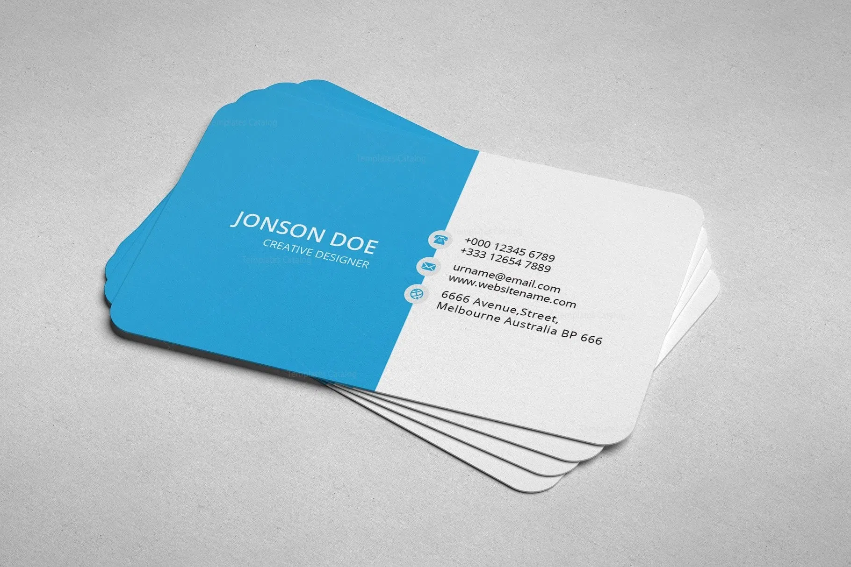
JONSON DOE
CERATIVEDESIGNER
+01988084015
aullah060@gmail.com
Design Ltd.
JONSON DOE
CERETIV DIGINER
+01988084015
auiiah060@gmail.com
Design Ltd.

Slide 6
C
S
M

